Slide 1

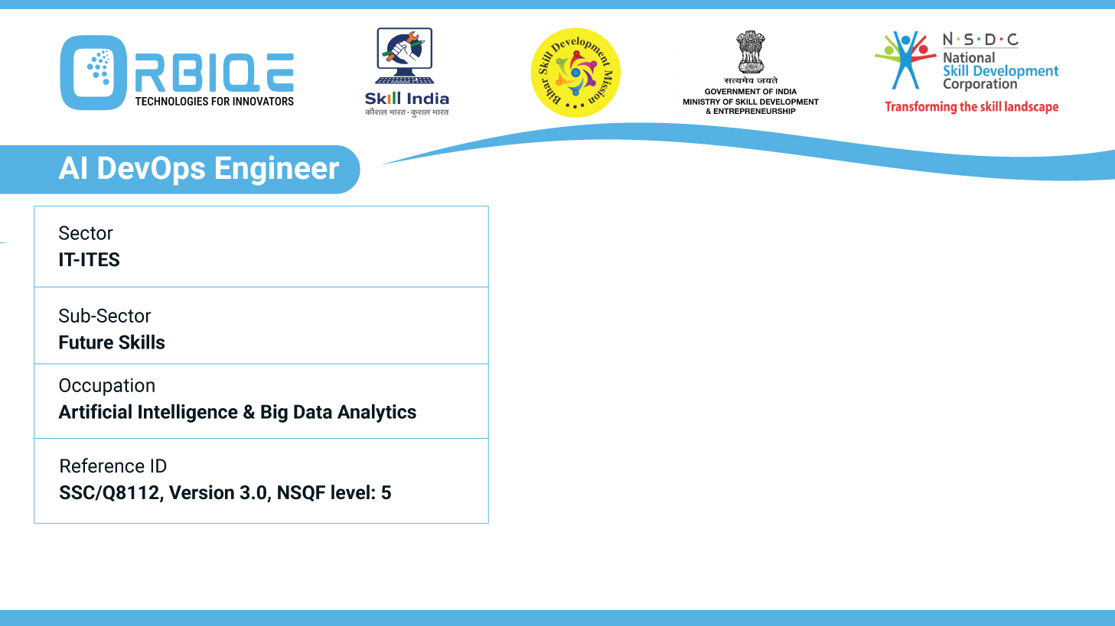
Name- Krishna Kant Dubey

Slide 2

Using Playbooks in Ansible for Configuration Management

Slide 3
Agenda
Define playbooks in YAML format with tasks and roles for managing configurations
Specify hosts and groups in playbooks to apply configurations to remote machines
Sequence multi-tier rollouts by defining dependencies and orchestrating tasks accordingly

Slide 4
Define playbooks in YAML format with tasks and roles for managing configurations

Slide 5
Specify hosts and groups in playbooks to apply configurations to remote machines

Slide 6
Sequence multi-tier rollouts by defining dependencies and orchestrating tasks accordingly

Slide 7
Thank You

